Slide 1

ROAD DAMAGE DETECTION AND CRACK SEGMENTATION USING DEEP LEARNING
Submitted by
Name: Aadeesh Ranjan
ID: 240353
Faculty Mentor
Dr. Shilpa Mahajan
Assistant Professor
SOET, BMU
Industry Mentor
Not Applicable (Academic Research Project)
PRACTICE SCHOOL-II
School of Engineering & Technology,
BML Munjal University, 67th KM Stone, NH-8, Gurugram, Haryana 122413
July 2026

Slide 2
OUTLINE OF THE PRESENTATION
Project Overview
Project Timeline
Introduction
Problem Statement
Objectives
Methodology
Detection Experiments
SAHI Evaluation
Segmentation Experiments
Recent Literature Comparison
Conclusions

Slide 3
PROJECT OVERVIEW
About the Project
Project Title: Road Damage Detection and Crack Segmentation using Deep Learning
Project Type: Bachelor's Thesis / Practice School-II
Research Area: Computer Vision and Deep Learning
Datasets: RDD2022 and Crack500
Research Scope
Object Detection
SAHI Evaluation
Crack Segmentation
Faculty Mentor Details
Name: Dr. Shilpa Mahajan
Department: SOET, BML Munjal University
Designation: Assistant Professor
Contact info: shilpa.mahajan@bmu.edu.in

Slide 4
PROJECT TIMELINE
Start date: 1st June, 2026
Project Milestones
Phase 1: Literature review and problem understanding completed.
Phase 2: Dataset preparation and exploratory data analysis completed.
Phase 3: YOLOv8 and YOLO11 object detection experiments completed.
Phase 4: SAHI evaluation and YOLO11m ablation study completed.
Phase 5: Faster R-CNN implementation and exploratory SAHI evaluation completed.
Phase 6: Crack segmentation using U-Net and DeepLabV3+ completed.
Phase 7: Comparison with recent literature and result analysis completed.
Phase 8: Documentation, thesis writing and presentation preparation in progress.
End date: 26th July, 2026

Slide 5
PROBLEM IDENTIFICATION
Statement: Road surface defects such as cracks and potholes reduce driving safety and increase road maintenance costs. Manual inspection is slow, expensive, and often inconsistent. An automated computer vision-based system can provide faster and more reliable road damage assessment.
Objectives:
Evaluate multiple deep learning models for road damage detection.
Study the impact of SAHI on small-object detection.
Compare U-Net and DeepLabV3+ for crack segmentation.
Benchmark the proposed models against recent literature.
Methodology:
Road Damage Detection using YOLOv8, YOLO11 and Faster R-CNN
SAHI-based sliced inference evaluation
Crack Segmentation using U-Net and DeepLabV3+
Performance evaluation using Precision, Recall, mAP, Dice Score and IoU

Slide 6
METHODOLOGY
Benchmark Datasets
RDD 2022 Dataset
Crack500 Dataset
Object Detection YOLOv8 • YOLO11 • Faster R-CNN
Crack Segmentation U-Net • DeepLabV3+
SAHI Based Inference
Segmentation Inference
Performance Evaluation
Precision • Recall • mAP@50 • mAP@50-95 • Dice • IoU
Comparison with Recent Literature

Slide 7
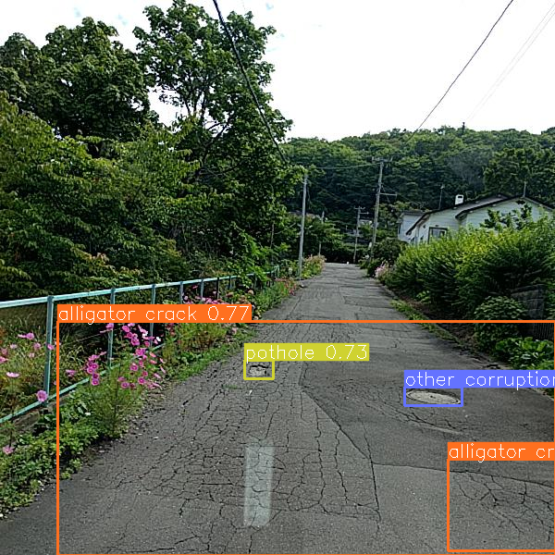
DETECTION EXPERIMENTS
Model | mAP@50 | mAP@50-95
YOLOv8n | 0.539 | 0.285
YOLOv8s | 0.592 | 0.317
YOLOv8m | 0.633 | 0.344
YOLOv11n | 0.544 | 0.287
YOLOv11s | 0.575 | 0.309
YOLOv11m | 0.587 | 0.314
Faster R-CNN | 0.536 | 0.253
Baseline performance comparison of all evaluated detection models.
Representative YOLOv8m predictions on the RDD2022 dataset.

Slide 8
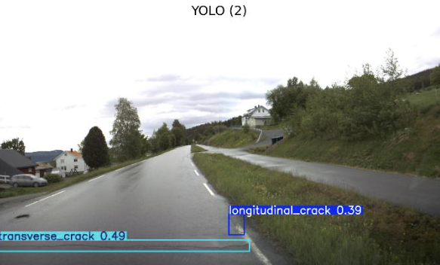
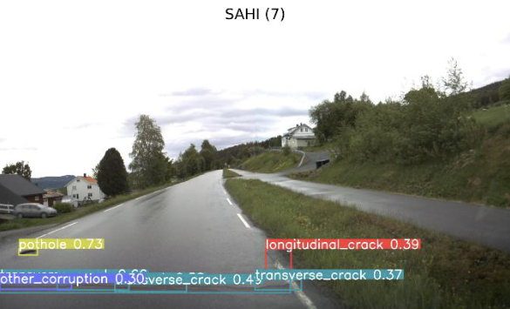
SAHI EVALUATION
Model | Baseline Detection | SAHI Detection | Detection Increase
YOLOv8n | 3773 | 4564 | 20.96%
YOLOv8s | 4237 | 5475 | 29.22%
YOLOv8m | 4551 | 5321 | 16.92%
YOLOv11n | 3612 | 4496 | 24.47%
YOLOv11s | 4016 | 4826 | 20.17%
YOLOv11m | 3986 | 4722 | 18.46%
Baseline YOLO vs. YOLO + SAHI Predictions
SAHI increased detections for every YOLO model.
YOLOv8s showed the largest improvement (29.22%).
The increase in detections was accompanied by additional false positives.

Slide 9
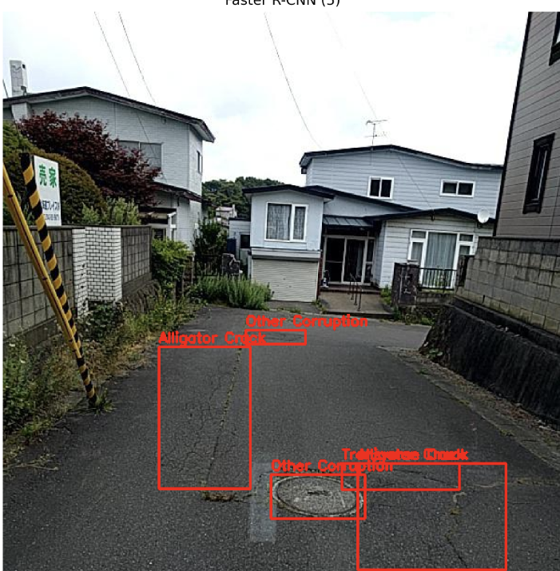
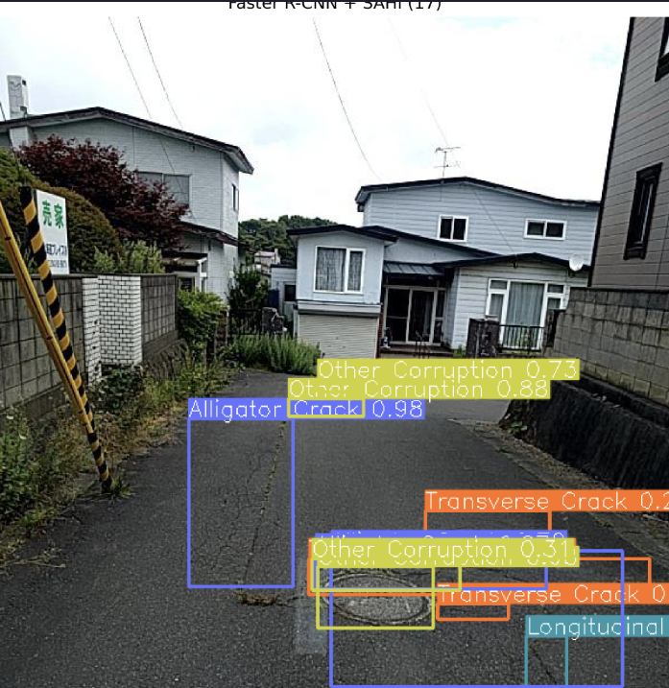
EXPLORATORY STUDY: FASTER R-CNN + SAHI
Model | Baseline Detection | SAHI Detection | Detection Increase
Faster R-CNN | 6899 | 11256 | 63.15%
Metrics | Value
Precision | 0.203
Recall | 0.271
mAP@50 | 0.203
mAP@50-95 | 0.086
Example showing additional detections after applying SAHI.
SAHI increased detections by 63.15%.
Many of the additional detections were false positives and duplicate boxes.
Therefore, Faster R-CNN + SAHI was treated as an exploratory study rather than the final approach.

Slide 10
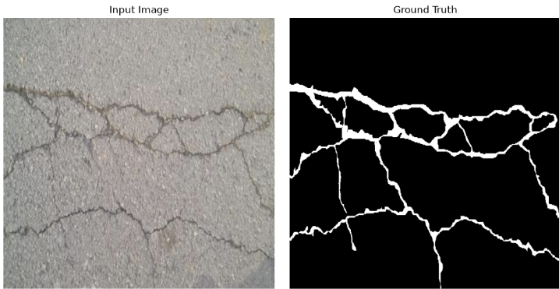
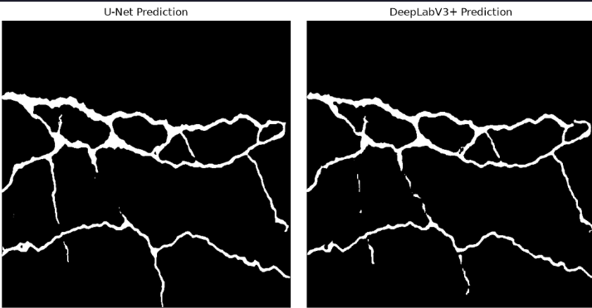
SEGMENTATION EXPERIMENTS
Model | Dice Score | IoU Score
U-Net | 0.7533 | 0.6118
DeepLabV3+ | 0.7389 | 0.5931
U-Net achieved the highest Dice Score (0.7533) and IoU (0.6118).
Both models successfully segmented the primary crack regions..
U-Net preserved thin crack structures better and was selected as the final segmentation model.
Segmentation results on a Crack500 sample image.

Slide 11
DETECTION LITERATURE COMPARISON
Method | Year | Dataset | mAP@50 | mAP@50-95
RDD-YOLO | 2024 | RDD2022 | 62.5 | 36.4
Improved YOLOv8 | 2024 | RDD2022 | 65.7 | —
YOLOv8-PD | 2024 | RDD2022 | 70.6 | 39.5
YOLO-RD* | 2025 | Japan Subset | 55.62 | 25.75
OBC-YOLOv8† | 2025 | China Subset | 86.0 | —
SEA-YOLOv8 | 2025 | RDD2022 | 63.2 | —
YOLOv8m | 2026 | RDD2022 | 63.3 | 34.4
YOLOv8m + SAHI | 2026 | RDD2022 | 48.4 | 24.7
YOLO-RD was evaluated on the Japan subset of RDD2022. OBC-YOLOv8 was evaluated on the China subset. Some papers report only mAP@50, so mAP@50-95 is unavailable.
Observation: YOLOv8m achieved competitive performance on the RDD2022 benchmark despite using a standard training pipeline without architectural modifications.

Slide 12
SEGMENTATION LITERATURE COMPARISON
Method | Year | Dataset | Dice (%) | IoU (%)
Pyramid Attention Network | 2020 | Crack500 | 76.81 | 62.35
Dual Flow Fusion Model* | 2023 | Crack500 | 78.10 | 66.00
Distribution-aware Noisy-label Learning | 2024 | Crack500 | 74.74 | 60.56
EGA-UNet† | 2025 | Crack500 | 77.80 | 70.00
U-Net | 2026 | Crack500 | 75.33 | 61.18
DeepLabV3+ | 2026 | Crack500 | 73.89 | 59.31
The Dual Flow Fusion paper reports F1-score, which is equivalent to the Dice coefficient for binary segmentation. EGA-UNet reports foreground IoU, which is directly comparable to the IoU used in this work.
Observation: U-Net achieved competitive performance on the Crack500 dataset and outperformed DeepLabV3+ in both Dice Score and IoU.

Slide 13
CONCLUSIONS
Key Findings
Evaluated seven object detection models on the RDD2022 dataset.
YOLOv8m achieved the best overall detection performance with 63.3% mAP@50 and 34.4% mAP@50-95.
SAHI increased the number of detected road damages for all YOLO models, with a maximum improvement of 29.22%.
The Faster R-CNN + SAHI study showed a 63.15% increase in detections but also introduced many false positives.
U-Net achieved the best crack segmentation performance with a Dice Score of 75.33% and an IoU of 61.18%.
Comparison with recent literature showed that the proposed models achieved competitive performance on benchmark datasets.

Slide 14
LEARNING OUTCOMES
Technical Skills
Gained hands-on experience with object detection and semantic segmentation.
Compared one-stage (YOLO) and two-stage (Faster R-CNN) detection models.
Evaluated the impact of SAHI on small-object detection.
Performed model evaluation using Precision, Recall, mAP, Dice Score, and IoU.
Research Skills
Conducted a comprehensive literature review.
Designed and compared multiple deep learning experiments.
Analyzed experimental results and benchmarked them against published research.
Improved technical writing and presentation of research findings.

Slide 15
REFERENCES
Arya, D., et al., RDD2022: A Multi-national Image Dataset for Automatic Road Damage Detection, Scientific Data, 2022.
Akyon, F. C., Altinuc, S. O., and Temizel, A., Slicing Aided Hyper Inference and Fine-Tuning for Small Object Detection (SAHI), ICIP, 2022.
Wang, C.-Y., Bochkovskiy, A., and Liao, H.-Y. M., YOLOv7: Trainable Bag-of-Freebies Sets New State-of-the-Art for Real-Time Object Detectors, 2022.
Ren, S., He, K., Girshick, R., and Sun, J., Faster R-CNN: Towards Real-Time Object Detection with Region Proposal Networks, NeurIPS, 2015.
Ronneberger, O., Fischer, P., and Brox, T., U-Net: Convolutional Networks for Biomedical Image Segmentation, MICCAI, 2015.
Chen, L.-C., et al., Encoder–Decoder with Atrous Separable Convolution for Semantic Image Segmentation (DeepLabV3+), ECCV, 2018.
Li, Y., et al., RDD-YOLO: Road Damage Detection Algorithm Based on Improved YOLOv8, Applied Sciences, 2024.
Zeng, J., and Zhong, H., YOLOv8-PD: An Improved Road Damage Detection Algorithm Based on YOLOv8n, Scientific Reports, 2024.
Wang, W., et al., YOLO-RD: A Road Damage Detection Method for Effective Pavement Maintenance, Sensors, 2025.
Zhang, S., et al., OBC-YOLOv8: An Improved Road Damage Detection Model Based on YOLOv8, PeerJ Computer Science, 2025.
Additional references used for the literature review are provided in the accompanying Summary Findings document.

Slide 16
COMPLETE DETECTION PERFORMANCE
Model | Precision | Recall | mAP@50 | mAP@50-95
YOLOv8n | 0.579 | 0.516 | 0.539 | 0.285
YOLOv8s | 0.626 | 0.553 | 0.592 | 0.317
YOLOv8m | 0.677 | 0.590 | 0.633 | 0.344
YOLO11n | 0.593 | 0.514 | 0.544 | 0.287
YOLO11s | 0.613 | 0.540 | 0.575 | 0.309
YOLO11m | 0.631 | 0.546 | 0.587 | 0.314
Faster R-CNN | N/A | 0.427 | 0.536 | 0.253
Precision is marked N/A because it was not computed during the Faster R-CNN baseline evaluation; the reported Recall and mAP values are from the COCO evaluator.
Observation: YOLOv8m achieved the highest overall detection performance across all evaluated models, obtaining the best Precision (0.677), Recall (0.590), mAP@50 (0.633), and mAP@50-95 (0.344).

Slide 17
COMPLETE SAHI PERFORMANCE
Model | Precision | Recall | mAP@50 | mAP@50-95
YOLOv8n | 0.380 | 0.285 | 0.380 | 0.186
YOLOv8s | 0.441 | 0.311 | 0.441 | 0.218
YOLOv8m | 0.484 | 0.347 | 0.484 | 0.247
YOLO11n | 0.380 | 0.277 | 0.380 | 0.184
YOLO11s | 0.421 | 0.301 | 0.421 | 0.207
YOLO11m | 0.412 | 0.301 | 0.412 | 0.203
The top table presents the complete SAHI evaluation across all YOLO models, while the bottom table shows the YOLO11m ablation study used to determine the optimal SAHI configuration
Slice Size | Confidence | Precision | Recall | mAP@50 | mAP@50-95
512×512 | 0.25 | 0.412 | 0.301 | 0.412 | 0.203
512×512 | 0.50 | 0.307 | 0.218 | 0.307 | 0.171
640×640 | 0.25 | 0.402 | 0.299 | 0.402 | 0.208
SAHI improved small-object detection across all YOLO models.
Additional detections came with increased false positives.
YOLOv8m remained the best-performing detector after applying SAHI.
Default configuration (512×512, confidence = 0.25) provided the best trade-off and was used for all remaining experiments.

